Slide 1

Fuzzy C-Means Clustering (FCM)

Slide 2
Fuzzy C-Means (FCM) is a clustering algorithm similar to K-Means but allows each data point to belong to multiple clusters with varying degrees of membership, rather than being assigned to a single cluster. It is particularly useful when data points are not clearly separable.

Slide 3
How Fuzzy C-Means Works:
1. Initialization: Choose the number of clusters C and initialize the membership matrix U randomly, where each element uij represents the degree of membership of data point i in cluster j.
2. Update Cluster Centers: Calculate the cluster centers based on the membership matrix.
3. Update Membership Matrix: Update the membership values based on the distance of each data point to the cluster centers.
4. Iterate: Repeat steps 2 and 3 until convergence (i.e., the membership matrix does not change significantly).

Slide 4
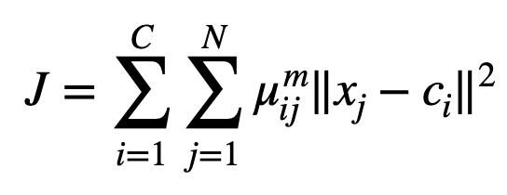
Objective Function:
The FCM algorithm aims to minimize the following objective function:
Where:
n is the number of data points.
c is the number of clusters.
uij​ is the degree of membership of xi​ in the j-th cluster.
m is the fuzziness parameter (usually m∈[1.5,3]).
cj​ is the cluster center of the j-th cluster.
∣xi−cj∣ is the Euclidean distance between the data point xi​ and cluster center cj​.

